Slide 1

OCN 479-001
Sensor communications
(Wired edition)

Slide 2
Today’s plan
Lecture
Finalize teams
Start building our new sensors in earnest

Slide 3
Assignment (due Sep. 29) 1 per group
Short presentation on your instrument
~5 minutes, just a couple slides
Most critical: methods/principles of operation—how does it work?!
Methods: how is it built, what does it do?
Principles of operation: how does it convert some physical (chemical, biological) quantity (e.g., conductivity) to a voltage (e.g., it transmits a voltage across the water and measures current flow, enabling the calculation of resistance and therefore conductance)?
What accuracy, precision, stability, and response time can we expect?

Slide 4
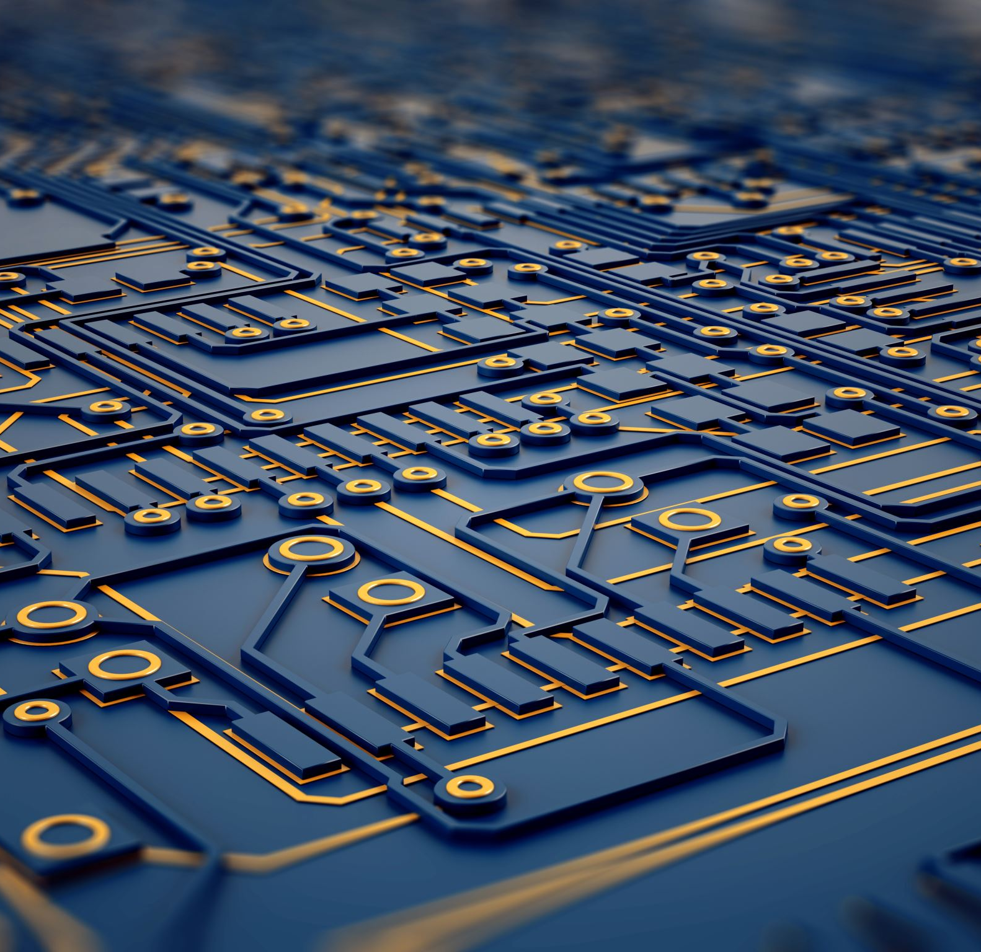
Today’s topics
Sensor Communications: (Wired edition)

Slide 5

Sensor Communications
How do we transmit information from some device (a peripheral) to the core microcontroller or computer?

Slide 6
Analog vs. Digital
Analog
Typically a current (4–20 mA) or voltage (0–3.3 V)
Often proportional to quantity of interest: e.g., T = (100 ºC/3.3 V)*Voltage
Can be other equations: famous one in oceanography is Steinhart–Hart Equation

Slide 7
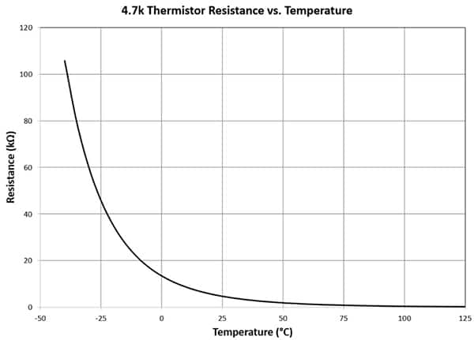
Steinhart–Hart Equation
A thermistor is a resistor that changes resistance based on temperature
Have known voltage drop across resistor; measure current; calculate resistance
Plug resistance into SHE: 1/T = A + B[ln(R)] + C[ln(R)]³
https://www.digikey.com/en/articles/quickly-create-an-accurate-thermistor-based-temperature-sensing-circuit

Slide 8
Analog vs. Digital
Analog
Digital
Typically a current (4–20 mA) or voltage (0–3.3 V)
Often proportional to quantity of interest: e.g., T = (100 ºC/3.3 V)*Voltage
Can be other equations: famous one in oceanography is Steinhart–Hart Equation
Sending bits (0s and 1s) and bytes (8 consecutive bits) with already translated information
01101010 = ???
Parallel vs. serial communications

Slide 9

Binary Two possible values: 0 or 1
Paul Revere: “One if by land, and two if by sea.”
How many lanterns lit —> code for possibilities of attack
Two lanterns means 2² = 4 possibilities
00 = Brits not coming
01 or 10 = coming by land
11 = coming by sea
(Sometimes we don’t use all available permutations)
https://chaddsfordhistorical.wordpress.com/2015/07/25/mythbuster-friday-one-if-by-land-two-if-by-sea/

Slide 10
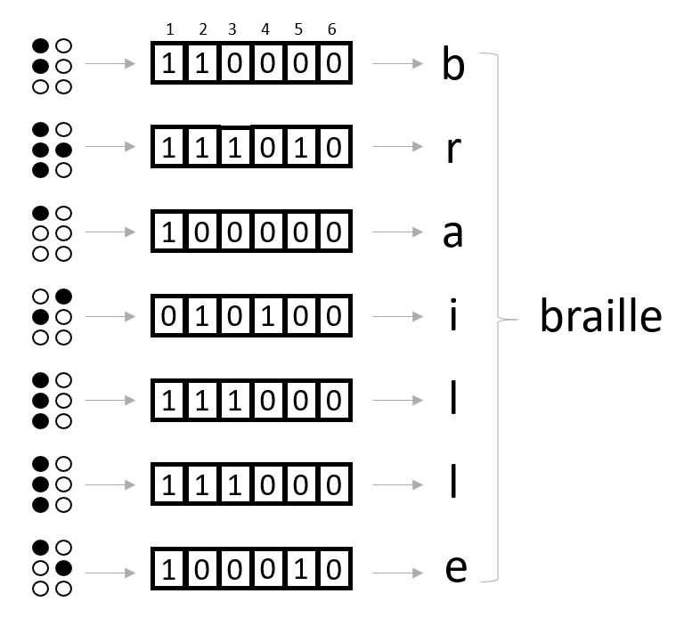
Binary Two possible values: 0 or 1
Braille letters use six raised or unraised bumps
This gives 2⁶ = 64 possibilities
100000 —> a

Slide 11
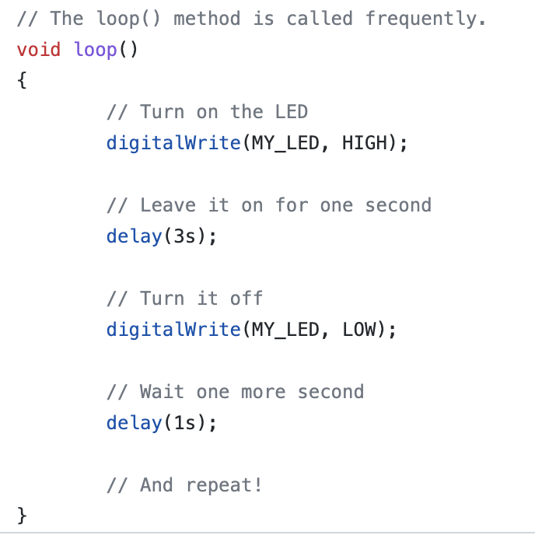
What if we’re using a microcontroller
HIGH = 1
LOW = 1
That’s good for one or two bits; what if we want to transmit large numbers?

Slide 12
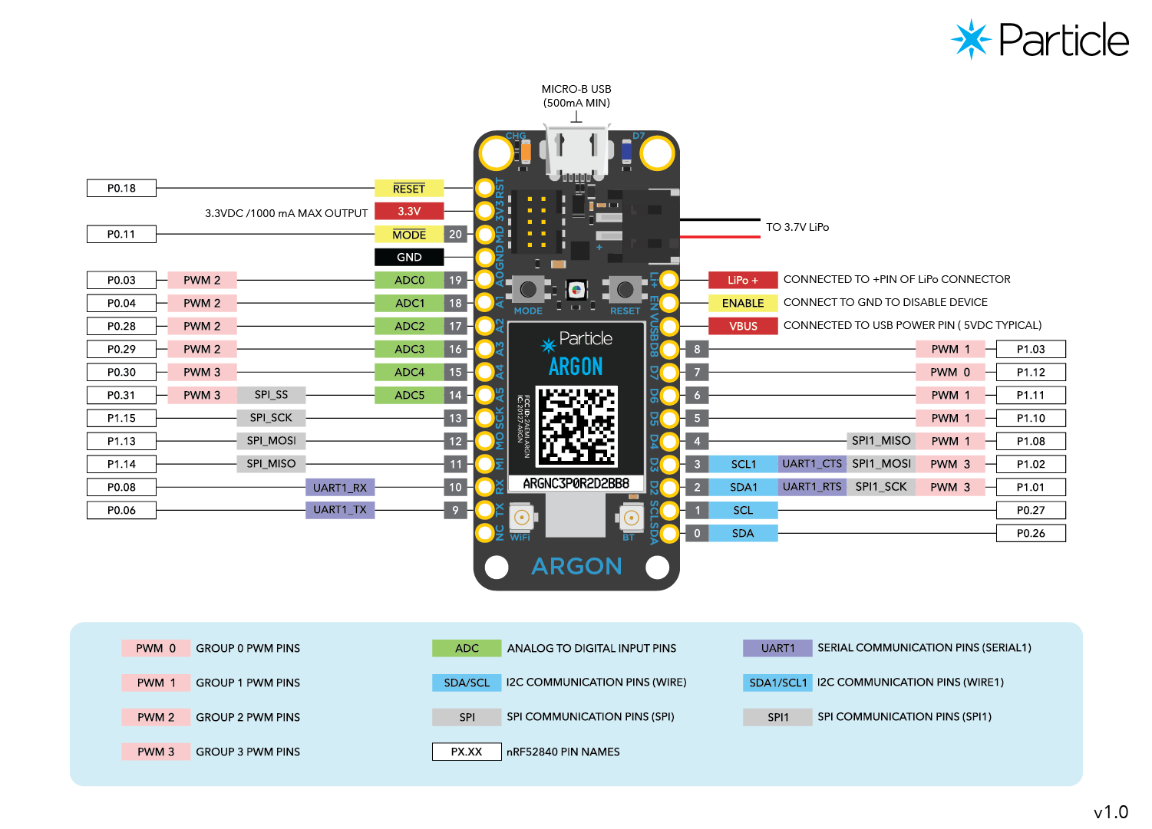
Particle Argon “pinout”
If we want to transmit an 8-bit value…
2⁸ = 256
Value could range from 0–255 inclusive

Slide 13
What if we want to transmit large numbers? Option 1: parallel
Example: we have a temperature sensor and we want to send digital data from it to our microcontroller
Pick 8 pins
Simultaneously send your 0s and 1s on each of the 8 pins of the thermometer to each of the corresponding 8 pins on the MCU (microcontroller unit)
Thermometer

Slide 14
What if we want to transmit large numbers? Option 1: parallel
Example: we have a temperature sensor and we want to send digital data from it to our microcontroller
Pick 8 pins
Simultaneously send your 0s and 1s on each of the 8 pins of the thermometer to each of the corresponding 8 pins on the MCU (microcontroller unit)
Very inconvenient: lots of wires, lots of parallel processing
Thermometer

Slide 15
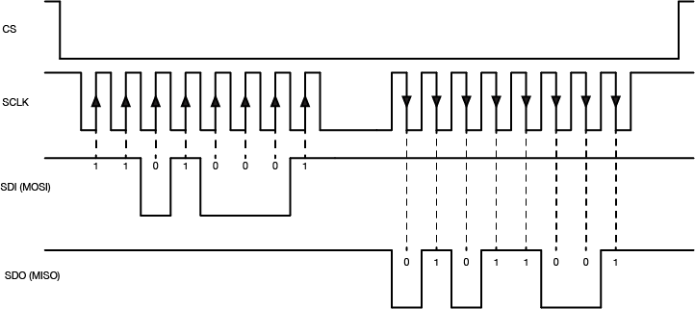
Option 2: Serial
Use one wire and pulse it up (1) and down (0)

Slide 16
Option 2: Serial
MAJOR (POTENTIAL) PROBLEM: how do we know how many consecutive 0s or 1s we have?
I.e., the code above is 11010001. But how do we know it’s not 1111001100000011?

Slide 17
Option 2: Serial
SOLUTION: use a second wire to send a clock (just regularly alternating 0s and 1s)
https://itp.nyu.edu/physcomp/lessons/synchronous-serial-communication-the-basics/

Slide 18
Serial wins, but different flavors
SPI: Serial peripheral interface
I2C: Inter-inter communications
UART: Universal asynchronous receive/transmit

Slide 19
Serial wins, but different flavors
SPI: Serial peripheral interface
I2C: Inter-inter communications
UART: Universal asynchronous receive/transmit
99% of people you work with in sensor applications will just refer to all of this (and more) as serial comms
In our work, we’ll use soldered/breadboarded wires
Could also use an RS-232 cable, RS-485 cable, Ethernet cable, …
These protocols have additional details that we won’t cover this semester, but look up if you need them for your device (or interest or job)!

Slide 20
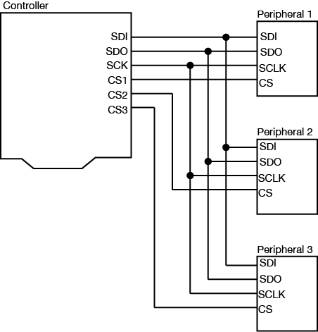
Serial: two more challenges 1. What if we want two-way comms?
Use one serial data in (SDI) wire
One serial data out (SDO) wire

Slide 21
Serial: two more challenges 2. What if we want multiple sensors connected?
Use multiple “chip select” (“CS”) wires but same data in/data
Note that same SDO and SDI lines go to all three peripherals
https://itp.nyu.edu/physcomp/lessons/synchronous-serial-communication-the-basics/

Slide 22

Digital (serial) comms gives us a bunch of 0s and 1s: what next?
Datasheet for chip will tell us how to interpret the bits and bytes
Computer/electrical engineers and people with lots of patience can write code to interpret these values
In this class, we’ll use “drivers”—prepackaged code chunks—to do the interpretation

Slide 23
Particle Argon “pinout”
Tells us what pins can be used for what functions
Sometimes multiples of a single function
SCL/SDA vs. SCL1/SDA1 means there are two I2C ports
Sometimes one pin can have multiple functions (we tell microcontroller what to use in firmware)

Slide 24
Analog vs. Digital
Analog
Digital
Typically a current (4–20 mA) or voltage (0–3.3 V)
Often proportional to quantity of interest: e.g., T = (100 ºC/3.3 V)*Voltage
Can be other equations: famous one in oceanography is Steinhart–Hart Equation
Good for sending “raw” voltages, instantly usable
Bad if noise could mess up reading
Sending bits (0s and 1s) and bytes (8 consecutive bits) with already translated information
01101010 = ???
Parallel vs. serial communications
Good for preventing data loss
Challenging because needs additional wires and (slightly) more complicated code/drivers

Slide 25

Combining the two: analog + digital
ADC: Analog-to-Digital Converter
Takes an analog voltage referenced to something and converts it to a digital number that can be recorded by the microcontroller
Recorded in ADC “counts” based on resolution of microcontroller
E.g., 12-bit ADC —> 2¹² = 4096 possible values
We have to convert this back to the actual voltage!
Scales proportionately: V = V_{ref}/4096*ADC_{counts}
V_{ref} is fixed property of your microcontroller (3.3 V for us)
ADC_{counts} is what your microcontroller recorded

Slide 26
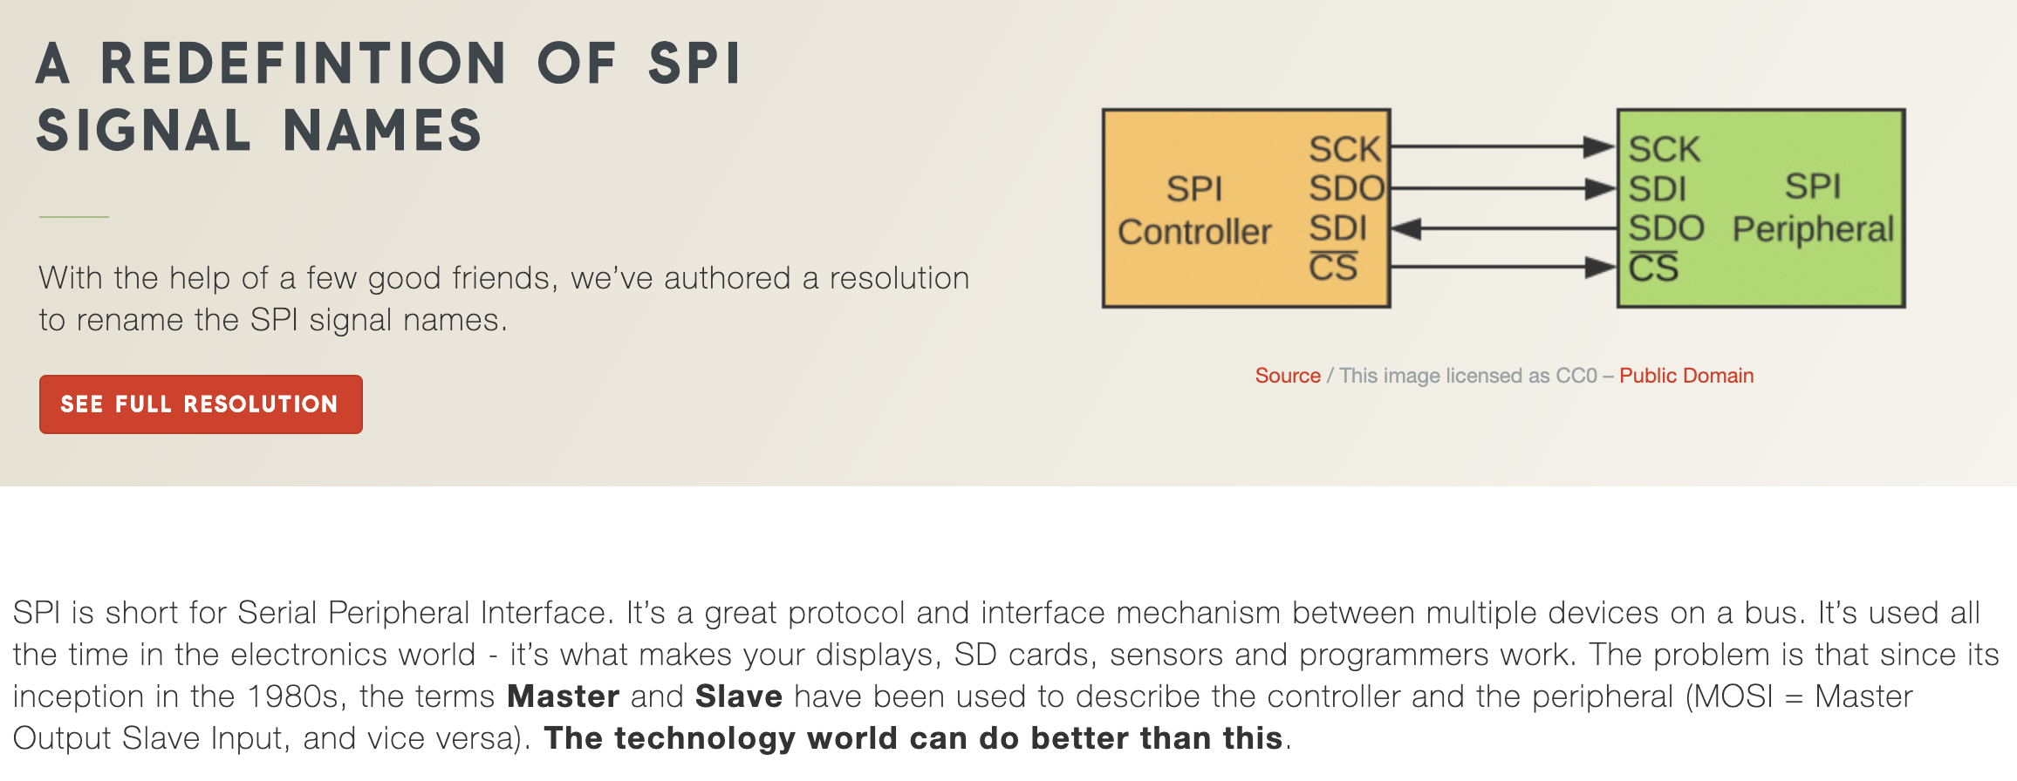
A final plea
Until recently, it was extremely common to see SPI wires described as MISO and MOSI. Now PICO and POCI are catching on; use these terms. See more here: https://www.sparkfun.com/spi_signal_names

Slide 27
Today’s lab
Create groups based on interest, strengths, number of students
Begin work on project of interest
Don’t just dive in: map out what you’ll need:
Circuitry?
Code?
Housing design?
?
START. TAKING. NOTES. Your main deliverables at end of semester are presentation on your sensor and a continuity report (where would someone get started if following your example?).
How will sensor(s) communicate with microcontroller?
How many sensors are involved?
How will you log data?
What peripherals will you need for other functions (e.g., GPS)?

Slide 28

Kayaking plans

